Slide 1
Children’s Literacy Project Quotes and Quiz
Junior League of Tampa

Slide 2
“Frederick Douglass taught that literacy is the path from slavery to freedom. There are many kinds of slavery and many kinds of freedom, but reading is still the path.”
Carl Sagan

Slide 3
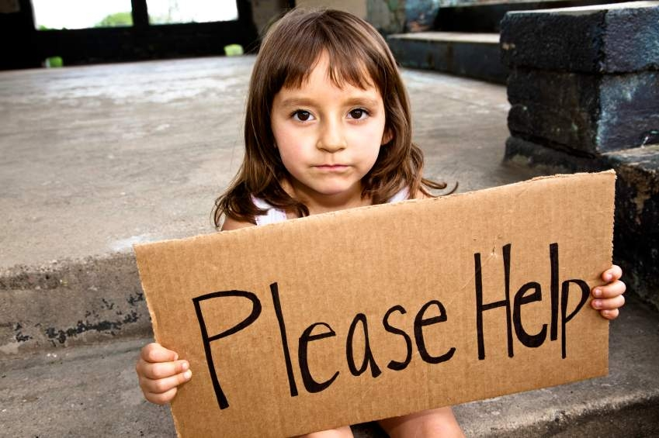
2/3 of students who cannot read proficiently by the end of 4th grade will end up in jail or on welfare.
www.begintoread.com/research/literacystatistics.html

Slide 4
Q: How many American children drop out of school each year?
230,000
579,000
1,000,000
3,000,000

Slide 5
Over one million children drop out of school each year, costing the nation over $240 billion in lost earnings, forgone tax revenues, and expenditures for social services
McQuillan, 1998

Slide 6
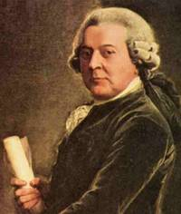
“When writing the constitution for the Commonwealth of Massachusetts, John Adams wrote: I must judge for myself, but how can I judge, how can any man judge, unless his mind has been opened and enlarged by reading.”
John Adams

Slide 7
Q: How many American adults would not be able to read a simple story to a child?
1.5 million
44 million
15 million
21 million

Slide 8
44 million adults in the U.S. can't read well enough to read a simple story to a child.
National Adult Literacy Survey (1992)
NCED, U.S. Department of Education

Slide 9
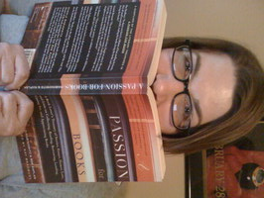
“We have created a culture of reading poverty in which a vicious cycle of aliteracy has the potential to devolve into illiteracy for many students. By allowing students to pass through our classrooms without learning to love reading, we are creating adults (who then become parents and teachers) who don't read much. They may be capable of reading well enough to perform academic and informational reading, but they do not love to read and have few life reading habits to model for children.”
Donalyn Donalyn Miller, The Book Whisperer
Awakening the Inner Reader in Every Child

Slide 10
In a class of 20 students, few if any teachers can find even 5 minutes of time in a day to devote to reading with each student.
Dr. M.J. Adams, 2002
Principal Scientist of Phonics instruction at Scholastic and
Literacy Advisor to Sesame Street

Slide 11
Q: Advantaged first graders typically have a vocabulary of 5,800 words. What is the typical vocabulary of a disadvantaged first grader?
1,200
4,400
2,900
5,100

Slide 12
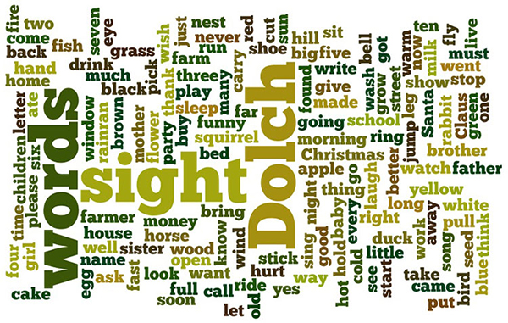
Disadvantaged students in the first grade have a vocabulary that is approximately half that of an advantaged student (2,900 and 5,800 respectively).
Graves, 1986 / White, Graves & Slater, 1990

Slide 13
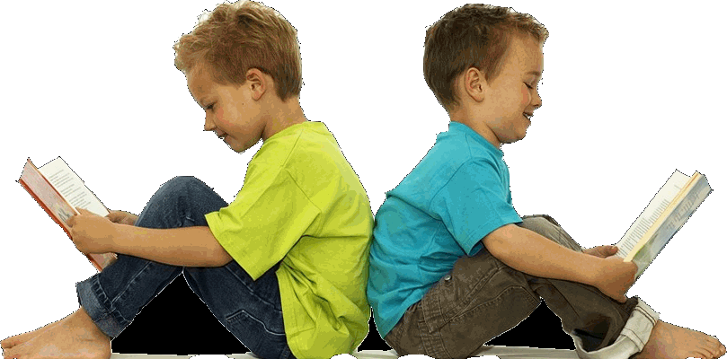
Good readers in 5th grade may read 10 times as many words as poor readers over a school year.
Nagy and Anderson, 1984

Slide 14
Q: What is the literacy rates for US 4th graders?
25%
90%
55%
33%

Slide 15
One third of 4th graders
nces.ed.gov/nationsreportcard/subject/publications/main2013/pdf/2014451.pdf

Slide 16
Q: In a recent study of literacy among 20 ‘high income’ countries; where did the US rank?
1st
4th
20th
12th

Slide 17
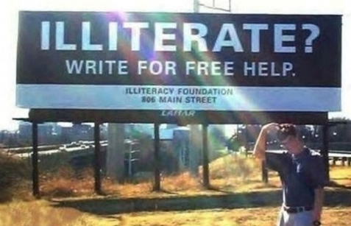
In a study of literacy among 20 ‘high income’ countries; US ranked 12th.
According to a report by the Educational Testing Service.

Slide 18
There are many little ways to enlarge your child’s world. Love of books is the best of all. —
Jacqueline Kennedy

Slide 19
Q: How likely are teenage girls between the ages of 16 to 19 who live at or below the poverty line and who have below average literacy skills to have children out of wedlock than girls their age who can read proficiently?
10% more likely
Twice as likely
Six times as likely
50% more likely

Slide 20
Teenage girls between the ages of 16 to 19 who live at or below the poverty line and have below average literacy skills are 6 times (600%) more likely to have children out of wedlock than girls their age who can read proficiently.
WriteExpress Corporation. "Literacy Statistics." Begin To Read

Slide 21
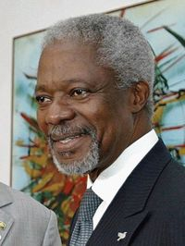
“Literacy is a bridge from misery to hope. It is a tool for daily life in modern society. It is a bulwark against poverty, and a building block of development, an essential complement to investments in roads, dams, clinics and factories. Literacy is a platform for democratization, and a vehicle for the promotion of cultural and national identity. Especially for girls and women, it is an agent of family health and nutrition. For everyone, everywhere, literacy is, along with education in general, a basic human right.... Literacy is, finally, the road to human progress and the means through which every man, woman and child can realize his or her full potential.”
Kofi Annan, Seventh Secretary-General of the United Nations
from January 1, 1997 to January 1, 2007

Slide 22
Q: What percentage of adults with very low literacy skills live in poverty?
95%
12%
43%
54%

Slide 23
43% of adult with very low literacy skills live in poverty.
The National Institute for Literacy

Slide 24
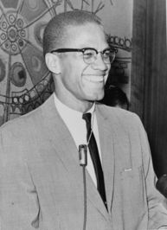
“People don't realize how a man's whole life can be changed by one book.”
Malcolm X

Slide 25
Q: The American Management Association found that what percentage of applicants have insufficient literacy for the position for which they are applying?
5.2%
24.5%
34.1%
17.9%

Slide 26
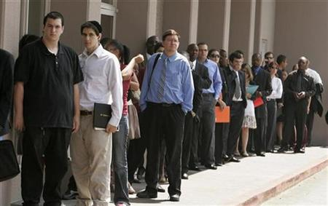
An American Management Association survey of member and client companies found that 34.1% of job applicants lack the literacy skills they need for the job for which they are applying.
U.S. Adult Literacy Programs: Making a Difference. ProLiteracy America

Slide 27
“There is no such thing as a child who hates to read; there are only children who have not found the right book.”
Frank Serafini

Slide 28
Q: What percentage of American workers have inadequate literacy skills?
15%
40%
22%
17%

Slide 29
JLT Children’s Literacy Project
U.S. Department of Education, Office of Vocational and Adult Education. April 2005

Slide 30
“One glance at a book and you hear the voice of another person, perhaps someone dead for 1,000 years. To read is to voyage through time.”
Carl Sagan

Slide 31
Q: There are 250 schools in Hillsborough County. Title I schools are those where 75% of the students are sufficiently disadvantaged that they qualify for free or reduced cost meals. Out of 250 schools, how many are Title I?
48 of 250
74 of 250
105 of 250
150 of 250

Slide 32
“Poor performance can track closely with poverty levels, and Title 1 schools account for 150 of Hillsborough’s 250 schools.”
Hillsborough County
School Board Website 2015

Slide 33
Q: Renaissance schools are those where over 90% of the students qualify for free meals. Out of 250 total schools in Hillsborough, how many are Renaissance Schools?
13 of 250
25 of 250
32 of 250
50 of 250

Slide 34
Fifty of those Title I schools are known as Renaissance schools, where at least 90% of the student body qualifies for free meals. Most of these schools received a C grade or lower from the Florida Department of Education.
Hillsborough County
School Board Website 2015

Slide 35
In Hillsborough County, approximately 58% of students qualify for free or reduced lunches. Below are the criteria for determining whether a student qualifies:
All children in households receiving benefits from SNAP (food stamps) or TANF, are eligible for free meals.
Foster children that are under the legal responsibility of a foster care agency or court are eligible for free meals.
Children participating in their school’s Head Start program are eligible for free meals.
Children who meet the definition of homeless, runaway, or migrant are eligible for free meals.
Children may receive free or reduced price meals if your household’s income is within the limits on the Federal Income Eligibility Guidelines. Children may qualify for free or reduced price meals if total household income falls at or below certain limits. As an example, a child living with a single mother whose income was below $20,709 per year would qualify for free meals.

Slide 36
One of the greatest gifts adults can give—to their offspring and to their society—is to read to children.
Carl Sagan

Slide 37
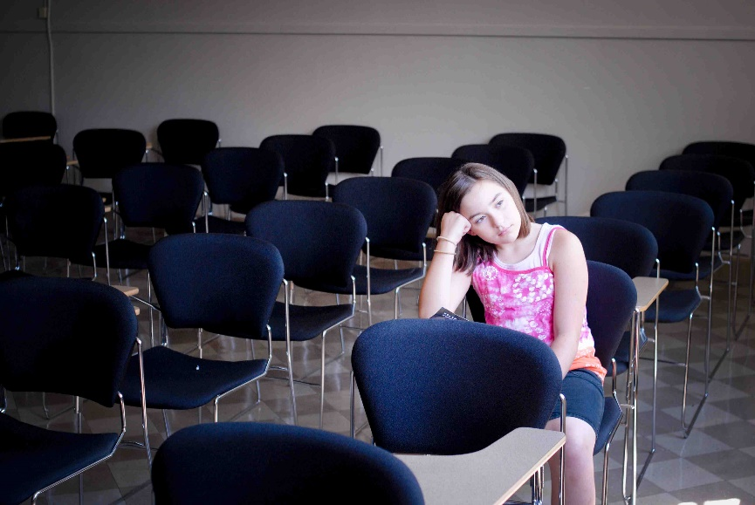
Students reading below grade level are twice as likely to drop out of school.
Source:2006 READ 180 Awards

Slide 38
“If literacy was natural, the word ‘illiteracy’ would not exist.”
T.K. Naliaka, A Difficult Damsel to Rescue

Slide 39
Teen girls in bottom 20% of basic reading and math skills are five times more likely to become mothers over a two year high school period than teen girls in the top 20%.
Source: Alliance for Excellent Education, 2003

Slide 40
More than 2.6 million adults in Florida— or 20 percent of those 16 and older — lack even the most basic reading skills.
Source: The National Center for Education Statistics (NCES)

Slide 41
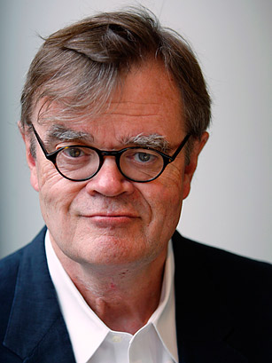
A book is a gift you can open again and again
Garrison Keillor
Host of the Minnesota Public Radio show A Prairie Home Companion

Slide 42
The average child growing up in a low-income family has only been exposed to 25 hours of one-on-one reading [during their entire life].
Source: McQuillan, J. (1998).
The Literacy Crisis: False Claims, Real Solutions. Heinemann.
(pulled from the “Reading Is Fundamental” website)

Slide 43
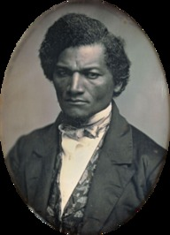
“Once you learn to read, you will be forever free.”
Frederick Douglass

Slide 44
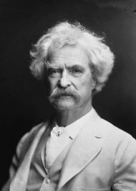
JLT Children’s Literacy Project
“The man who does not read has no advantage over the man who cannot read.” ― Mark Twain

Slide 45
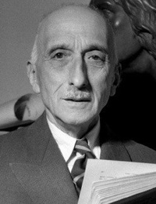
“If you would tell me the heart of a man, tell me not what he reads, but what he rereads.”
François Mauriac

Slide 46
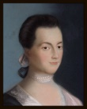
“My bursting heart must find vent at my pen.”
Abigail Adams

Slide 47
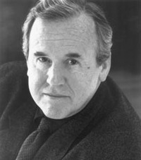
“Wherever they went the Irish brought with them their books, many unseen in Europe for centuries and tied to their waists as signs of triumph, just as Irish heroes had once tied to their waists their enemies' heads. Where they went they brought their love of learning and their skills in bookmaking. In the bays and valleys of their exile, they reestablished literacy and breathed new life into the exhausted literary culture of Europe. And that is how the Irish saved civilization.”
Thomas Cahill

Slide 48
“Art is literacy of the heart.”
Elliot Eisner

Slide 49
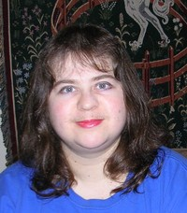
“Whenever you read a good book, somewhere in the world a door opens to allow in more light.”
Vera Nazarian Two-time Nebula Award Nominee, award-winning artist

Slide 50
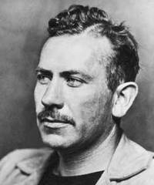
“Learning to read is probably the most difficult and revolutionary thing that happens to the human brain and if you don't believe that, watch an illiterate adult try to do it.”
John Steinbeck

